Slide 1


Session1:
Intro to STM32
CUERT

Slide 2

CAIRO UNIVERSITY ECO-RACING TEAM
Embedded Systems Concepts
Agenda
1
Programming concepts
2
STM32 Cube IDE
3
MORE MILES TO ACHIEVE
WWW.CU-ECO.ORG

Slide 3
TEAM TIME
CAIRO UNIVERSITY ECO-RACING TEAM
Embedded Systems Concepts
Embedded Systems
ARM Architecture
MORE MILES TO ACHIEVE
WWW.CU-ECO.ORG

Slide 4
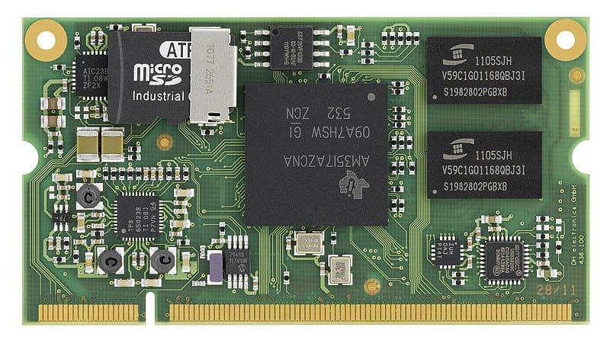

Embedded systems
CAIRO UNIVERSITY ECO-RACING TEAM
What’s an Embedded System
A combination of software and hardware
Performs a specific task as a part of larger system
MORE MILES TO ACHIEVE
WWW.CU-ECO.ORG

Slide 5


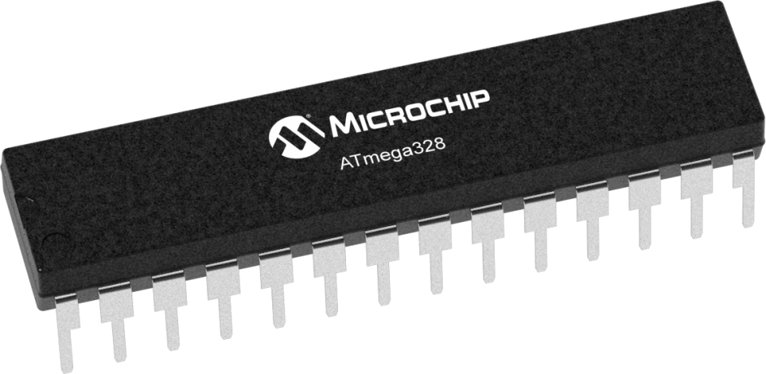

Embedded systems
CAIRO UNIVERSITY ECO-RACING TEAM
What’s an Embedded System
Embedded system is a system include software[Programing language] and hardware[Microcontroller]combination to Reach specific target.
Specific Target
Embedded System
MORE MILES TO ACHIEVE
WWW.CU-ECO.ORG

Slide 6
Embedded systems
CAIRO UNIVERSITY ECO-RACING TEAM
What’s an Embedded System
An embedded system is a specialized computing system designed to perform dedicated functions or tasks within a larger system. Unlike general-purpose computers, embedded systems are optimized for efficiency, reliability, and real-time performance.
Specific Target
Embedded System
MORE MILES TO ACHIEVE
WWW.CU-ECO.ORG

Slide 7
Embedded systems
CAIRO UNIVERSITY ECO-RACING TEAM
Embedded system and computing system
Embedded system | computing system
Specialized system designed for a specific task | System designed for multiple tasks and user interactions
Optimized for low power consumption | Higher power requirement
Ex: washing machines, ATMs , automotive ECUs | Ex : Laptops, desktops, smartphones
MORE MILES TO ACHIEVE
WWW.CU-ECO.ORG

Slide 8
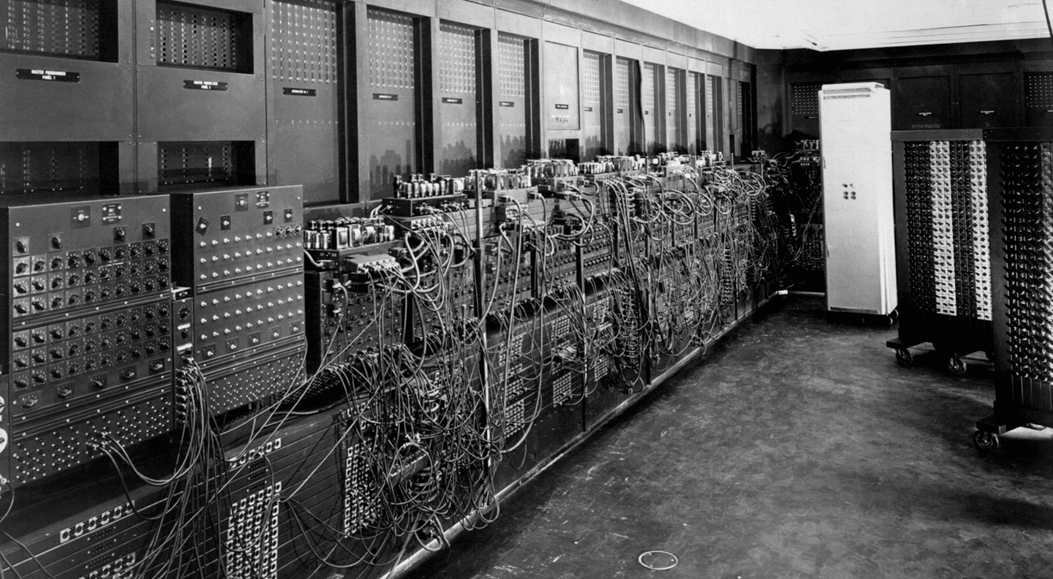
Embedded systems
CAIRO UNIVERSITY ECO-RACING TEAM
MORE MILES TO ACHIEVE
WWW.CU-ECO.ORG

Slide 9
TEAM TIME
CAIRO UNIVERSITY ECO-RACING TEAM
Autonomous subteam
Autonomous development
Autonomous embedded
MORE MILES TO ACHIEVE
WWW.CU-ECO.ORG

Slide 10

CAIRO UNIVERSITY ECO-RACING TEAM
57% passed
MORE MILES TO ACHIEVE
WWW.CU-ECO.ORG

Slide 11

Thank You Slide
MORE MILES TO ACHIEVE
WWW.CU-ECO.ORG

